Slide 1
NATURAL LANGUAGE PROCESSING
(NLP)

Slide 2
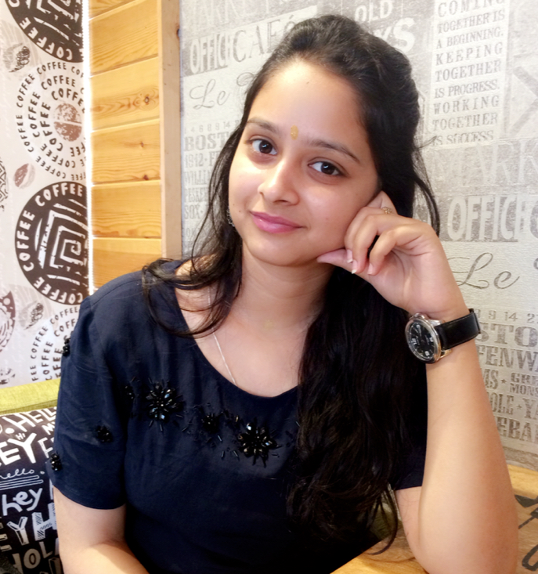
ABOUT MYSELF
ARUSHI SHARMA
MCA 2ND YEAR
INDIRA GANDHI DELHI TECHNICAL UNIVERSITY
ACM India Winter School (NLP)
Text Summarization Project

Slide 3
CONTENT:
What is NLP?
Applications of NLP.
Text Data and Concepts of NLP.
Key techniques related to NLP.
How these techniques can implement on real data set.

Slide 4



APPLICATIONS
Search Engines
Google Translate
Conversational Systems

Slide 5
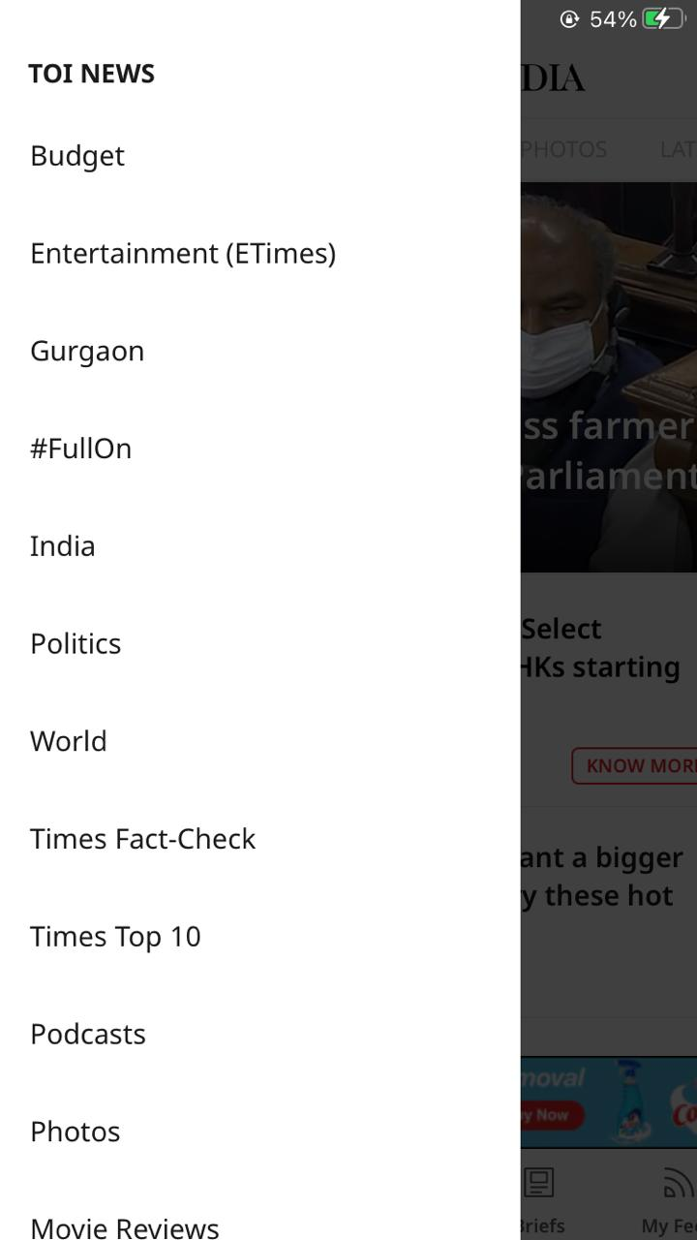
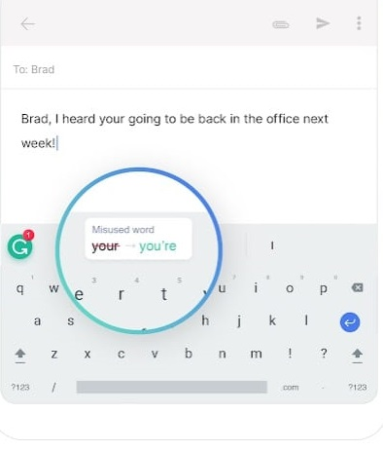
APPLICATIONS
News Categorization
Spelling Corrections

Slide 6
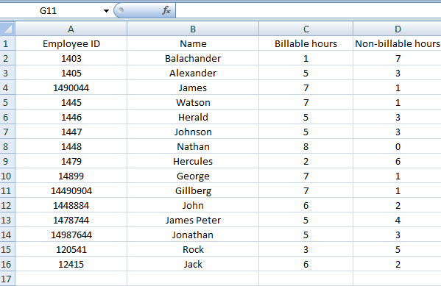
DATASETS AND ITS TYPES
A data set is an ordered collection of data. While handling the data, the data set can be a bunch of tables, schema and other objects.
Structured Dataset:
Fixed dimensions
Well organized
Tabular-data, Key-value pairs

Slide 7
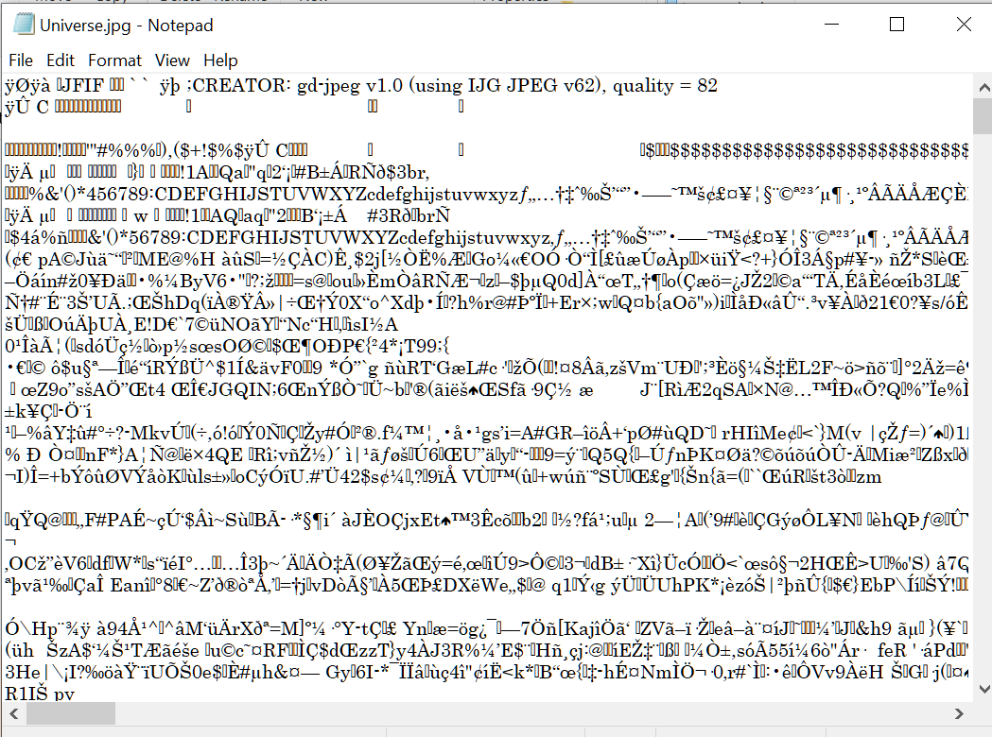
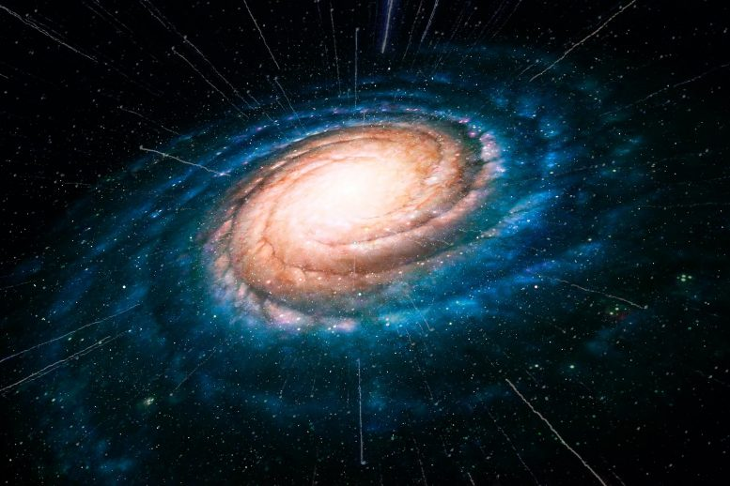
DATASETS AND ITS TYPES
Unstructured Dataset:
No fixed dimensions, no structure
Audio, videos, images, text.

Slide 8
TEXT DATASET
Examples of text datasets:
Conversations: messages ,email, chats.
Social media : tweet, posts, comments.
Words arranged in a meaningful manner
Written form of language.
Grammer and defined structured.

Slide 9
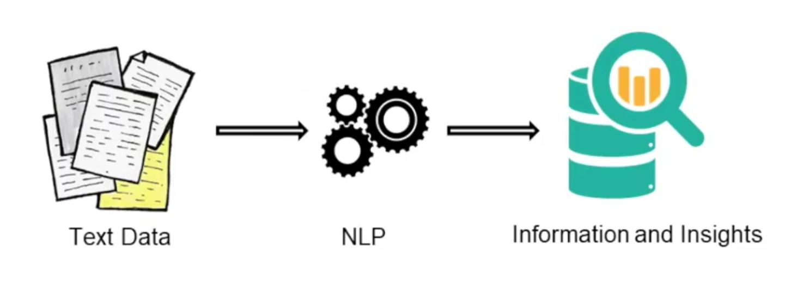
NATURAL LANGUAGE PROCESSING (NLP)
Deriving useful information from text.
Applied NLP: NLP + Human interaction.

Slide 10
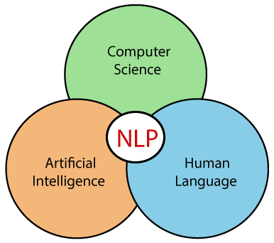
INTRODUCTION ON NATURAL LANGUAGE PROCESSING
The field of study that focuses on the interactions between human language and computers is called Natural Language Processing, or NLP for short.
It sits at the intersection of computer science, artificial intelligence, and computational linguistics.

Slide 11
TECHNIQUES RELATED TO NLP
Corpus, Tokens and N-Grams.
Tokenization.
Stemming
Lemmatization
Part of Speech Tagging
Dependency Grammer.

Slide 12
Corpus, Tokens and N-grams
Corpus: Collection of Text documents.
Corpus > Documents > Paragraphs > Sentences > Tokens
Tokens: Smaller units of a text ( words, phrases, ngrams)
N-grams: Combination of N words/characters together.
For example:
Sentence: My favourite colour is red.
Unigram (n=1) : My, favourite, colour, is, red.
Bigrams (n=2) : My favourite, favourite colour, colour is, is red.
Trigrams (n=3) : My favourite colour, favourite colour is, colour is red.

Slide 13
TOKENIZATION
Process of splitting a text object into smaller units (tokens)
Smaller Units: words, numbers, symbols, ngrams, characters.
White space tokenizer/ Unigram tokenizer
Sentence : “I went to New-York for higher studies”
Tokens : “I”, “went”, “to”, “New-York”, “for”, “higher”, “studies”
Regular expression tokenizer
Sentence : “Football, Cricket, Golf, Tennis”
re.split(r’[;,\s]’, line)
Tokens : “Football”, “Cricket”, “Golf”, “Tennis”

Slide 14
Normalization
Morpheme: base form of a word
Structure of token : <prefix> <morpheme> <suffix>
Example: Antinationalist : Anti + national + ist
Normalization: Process of converting a token into its base form(morpheme)
Helpful in reducing data dimensionality, text cleaning.
Types:
Stemming
Lemmatization

Slide 15
NORMALIZATION: STEMMING
Elementary rule based process of removal of inflectional forms from a token.
Outputs will be the stem of the word.
“laughing” , “laughed”, “laughs”, “laugh” >>> “laugh”
May generate non-meaningful terms.
his teams are not winning
>> hi team are not winn

Slide 16
NORMALIZATION: LEMMATIZATION
Systematics process for reducing a token to its lemma.
Makes use of vocabulary, word structure, part of speech tags and grammar relations
Example:
am, are, is >> be
running , ran, run, rans >> run
Running, ‘verb’ >> run
Running, ‘noun’ >> running

Slide 17
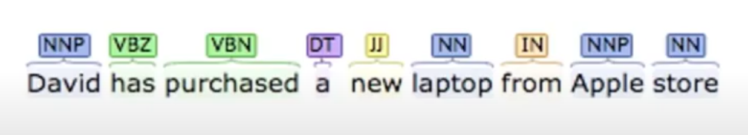
PART OF SPEECH TAGS
Defines the syntactic context and role of words in the sentence.
Common POS Tags: Nouns, Verbs, Adjectives, Adverbs.
Sentence: David has purchased a new laptop from Apple store.
Defined by their relationship with the adjacent words.
Machine Leaning and Rule-based process.

Slide 18
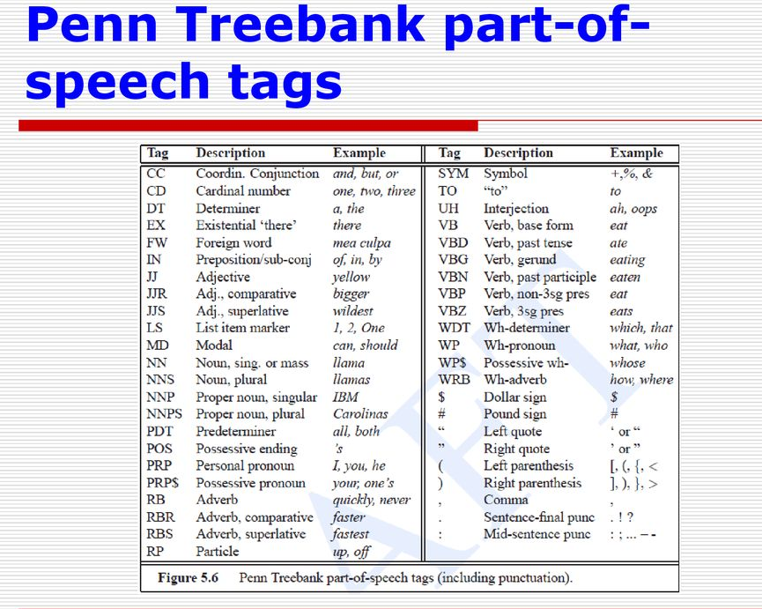

Slide 19
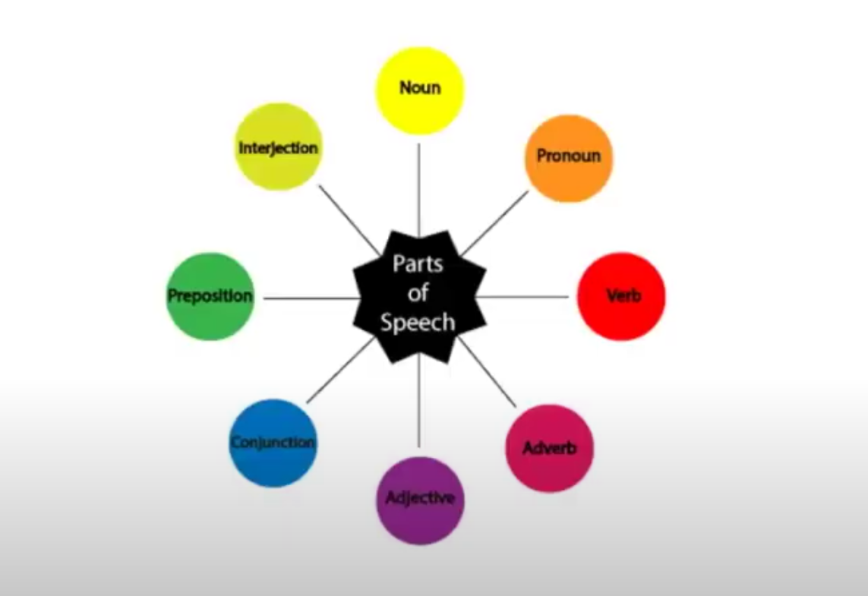

Slide 20
PART OF SPEECH
Uses:
Text Cleaning
Feature engineering tasks
Word sense disambiguation
For example:
Sentence 1: Please book my flight for New-York.
Sentence 2: I like to read a book on New-York.

Slide 21
CONSTITENCY GRAMMER
Constituents: Words / phrases / group of words
Constituency Grammar: Organize any sentence into constituents using their properties.
Properties: Part of Speech Tags / Noun phrases / Verb phrases.
Sentence: <subject> <context> <object>
<subject> The cats/ The dogs/ They
<context> are running/ are barking/ are eating
<object> in the park/ happily/ since the morning
Another view (using part of speech)
< DT NN > <JJ VB> < PRP DT NN> → The dogs are barking in the park.

Slide 22
DEPENDENCY GRAMMER
Words of a sentence depends on which other words (dependencies)
Example: Modifiers (Barking dog)
Organize words of a sentence according to the dependencies.
All the words are directly or indirectly linked to the root using links
These dependencies represents relationship among the words in a sentence

Slide 23
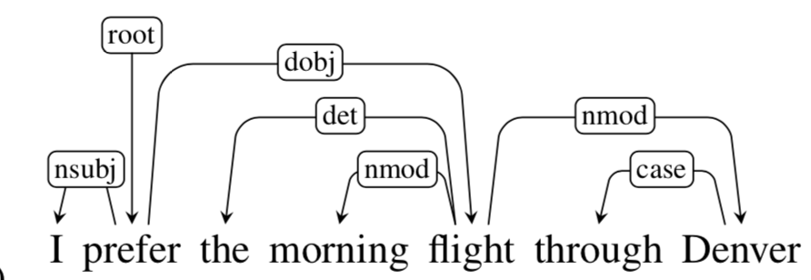
DEPENDENCY GRAMMAR
Sentence: I prefer the morning flight through Denver.

Slide 24
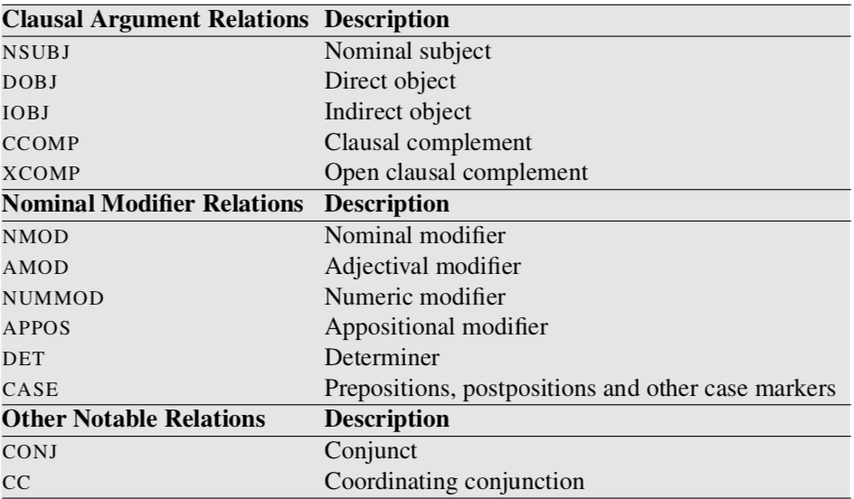
DEPENDENCY GRAMMAR

Slide 25
DEPENDENCY GRAMMAR- USE CASES
Named Entity Recognition
Question Answering Systems
Coreference Resolution
Text Summarization Problems
Text Classification Problems

Slide 26
GET MORE INFORMATION ABOUT NLP or ANY OTHER QUERIES
Mail : emarushi08@gmail.com
Github: https://github.com/arushi-11
Linkedln: https://www.linkedin.com/in/arushi11/

